Slide 1
2020 WHS Implementation PART 2, Zimbabwe

Slide 2
Club Responsibilities
from now to implementation date

Slide 3
Information for dissemination
ZGA will be the primary source of information for any WHS related questions
Poster is available to be customized for Zimbabwe. Can be printed and displayed at Clubs as well as emailed to members.

Slide 4
Midnight,
day before switch over
to “new”
Handicap system

Slide 5
Standardization of Handicaps
Switch over from Handicaps to HI – Midnight
Full recalculation of Score Differentials of last 20 scores entered, incorporating the CR and SR of the courses played
Ave of 8 best Score Differentials = HI (Handicap Index), which will be on the HNA/Handicap web site and the mobile app.
The HI will most likely be lower than the current handicap.
An example follows, using only 3 differentials, to illustrate why 2 golfers with the same handicap before may have different HI’s after the standardization run.

Slide 6
Same Hcp Before , Different HI After
Players - A & B- both current Hcp 15
Courses below : Par 72 and course ratings of 72
Payer A Player B
Course | Adj. Gross | CR/SR | Curr Diff | New Diff
Club A | 87 | 72,8/139 | 15 | 11,5
Club B | 88 | 74,1/143 | 16 | 11,0
Club C | 85 | 72,0/133 | 13 | 11,0
Ave. |  |  | 14.7 | 11,2
 |  |  | Hcp 15 | HI 11.2
Course | Adj. Gross | CR/SR | Curr Diff | New Diff.
Club X | 87 | 73,1/137 | 15 | 11,5
Club Y | 86 | 72.9/135 | 14 | 11.0
Club Z | 88 | 74,9/149 | 16 | 9,9
Ave |  |  | 15,0 | 10,8
 |  |  | Hcp 15 | HI 10,8

Slide 7
Standardization Example for 19 Handicap Golfer
Assumptions:
10 best gross scores for this golfer are 91 on his home club from White tees with current rating of 72 and Par 72
Current Handicap Calculation : 91 - 72 = 19
White Course : Course Rating is 72.3 and Slope rating 135 and Par 72
Calculation of Handicap Index using Course Rating System:
(Adj Gross score – CR)* 113/Slope Rating:
91 – 72.3 = 18.7 * 113/135 = 15.7
Therefore : Handicap Index on Implementation date will be 15.7
Golfer plays on the same White Course 2 days after implementation , thus Slope 135 and Course rating 72.3
The Course Handicap will be
HI*Slope rating/113+ (CR-Par):
15.7 x 135/113 + 0.3 = 19.1 rounded to 19

Slide 8
What will disappear | What is new
Handicaps | Handicap Index (HI) (Demonstrated Ability) Course Handicap (CH) (use this to complete scorecard)
Championship/Club/Senior/ Forward/Ladies tees | Colour Courses (tee) Mostly Yellow , White, Blue and Red
Know what handicap to use | Get your CH before you tee off
Current Rating | Course Rating (CR) and Slope Rating (SR)
Ladies tees separated from “men’s” tees on scorecard | Colour courses will be grouped, CH and HI and course colour to be noted on scorecard
Little or no choice on which tee can be used | Men can play all colour courses and Women, those rated for them

Slide 9
Some practical advice

Slide 10
Common types of club competitions/games
Use Handicap Index when stipulating the Terms of Competition e.g. maximum HI is 15.0
Spreads/Divisions determined by stipulating Handicap Index
Can use current division numbers. Look up HI on CHCT which equates to the current number for colour tee most used for each gender
Best Gross Score competitions - determine “course” to be played for competition. Suggest HI as guideline, if applicable to more than one course.
Match play - no change - lowest Course Handicap to scratch and other golfers Course Handicaps adjusted
Stableford competitions - no change - use Course Handicap to complete scorecard
When golfers play a different colour course (tee), use Course Handicap - NO further adjustments because CR to Par differential is accounted for in CH calculation !!

Slide 11
Rules of Handicapping

Slide 12
Key Elements to be in place for 2020
All courses MUST be rated using the CRS (Course Rating System) method – Foundation for WHS
All Handicap Management Systems in the world MUST use the WHS technical specifications
All countries in the world will be using the same method to determine Adjusted Gross Scores and calculate Score Differentials
All golfers in the world will have a fully transportable Handicap Index (HI) if Handicapped by an Authorised National Association
All Course Handicap (CH) calculations will be done using the same method

Slide 13
World Implementation Schedule
Who will be ready to implement January 2020 ?
All the major golfing countries, including the SADC countries, except CONGU confirmed to go live Q4, 2020
SADC readiness :
Botswana, eSwatini, Lesotho, Namibia, South Africa, Zambia, Malawi ,Tanzania, Mozambique and DRC
Seychelles and Mauritius: January 2020
Zimbabwe January 2020 ??
Madagascar, Angola and Comoros TBC

Slide 14
Rules of Handicapping
Follow same format as Rules of Golf
Consist of 7 Rules:
Purpose and Authorization; Obtaining a Handicap Index
Scores Acceptable for Handicap Purposes
Adjustment of Hole Scores
Submitting a Score
Handicap Index Calculation
Course Handicap and Playing Handicap Calculation
Committee Actions

Slide 15
Acceptable Score Requirements
Objective: Golfers should submit ALL acceptable scores. The more scores entered the more accurate the HI reflects their Demonstrated Ability as a golfer.
Rounds must be opened/registered (HNA smartphone app)
Must have a marker: another person or player
Max score per hole: Nett Double Bogey or Par +5 for HI ≥ 54 and new golfers
CH based on CR/SR for front or back nine if only 9 holes are played
Round played on a rated course
Round played in accordance with the Rules of Golf
Must be an Approved Format of Play over not less than 9 holes
Must be submitted before 24h00 but NLT 24 hours after the day of play and available for peer review

Slide 16
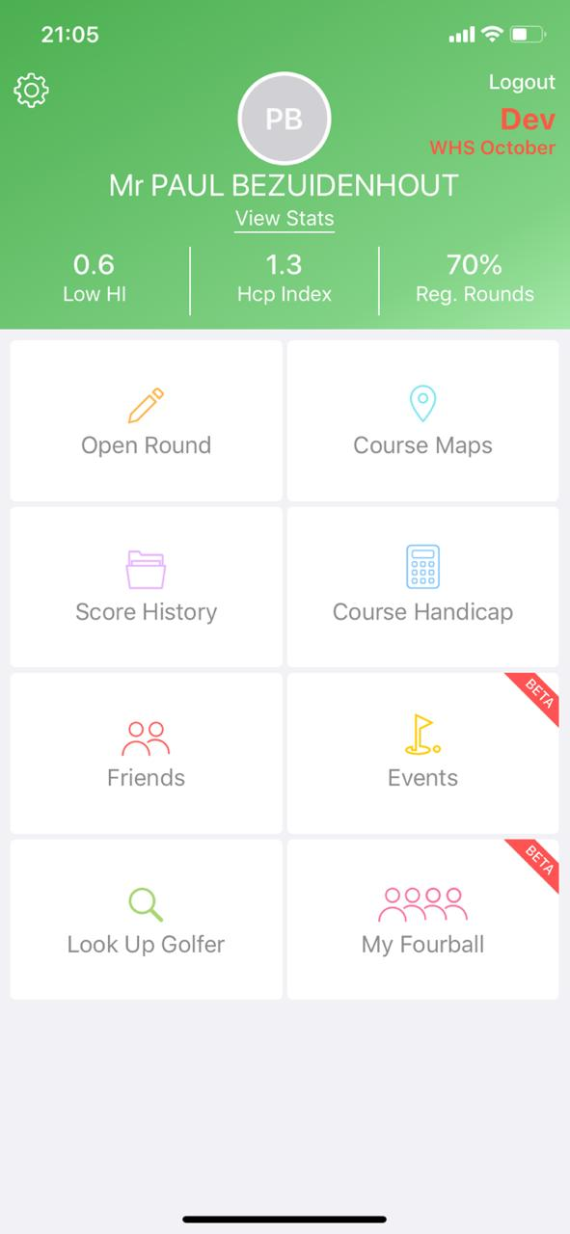

Slide 17
Authorized Formats of Play: Not less than 9 holes
General Principle
All formats of Play where the player plays his/her own ball in either an Organised events or General Play (recreational)
Individual Stroke Play (Organised or General Play)
Individual Stableford. (Organised or General Play)
Individual Par/Bogey (Organised or General Play)
Individual Match Play(Organised or General Play)
Individual Maximum Score(Organised or General Play)
Four ball ( Better ball) Stroke Play(Organised or General Play)
Four ball (Better ball) Stableford Play (Organised or General Play)
Four ball Alliance 1 or more scores to count Stableford Play (Organised )
Four Ball (Better ball) Par/Bogey (Organised or General Play)
Four Ball (Better ball) Match Play (Organised or General Play)

Slide 18
Unacceptable scores: October 01 2019
General Principle
All formats of Play where the player does NOT play his/her own ball in either Organised events or General Play (Recreational)
Unauthorised formats of Play
Foursomes ( Also known as Alternate Shot)
Scrambles
Other:
No marker present
When practicing or being coached
When using non-conforming equipment
When the minimum number of holes have not been played
Not played according to the Rules of Golf
Played an unrated course

Slide 19
Play by the Rules of Golf
Local Rules to be compliant with Model Local Rules: 2019 Rules of Golf
No preferred lies (placing) unless warranted on the day/season. Can be applied on specific holes only.
Note: A score is acceptable if a player gained no advantage and was DQ’d i.e. for not signing scorecard or used a metering device if not allowed in the Local Rules of the club but Final decision to allow submission remains at discretion of the Committee

Slide 20
Play on a Rated Course
A score is acceptable only if the player played on a rated course
If course has been set up differently to the APL of the rated course the score is NOT acceptable and may not be entered for Handicapping purposes.
The player MUST use the appropriate CH for the course they play and Indicate it on the scorecard
Stroke Indexing should be done in accordance with the guidelines.
If only 9 holes are played , the player MUST use the appropriate CH for the 9 holes of the course they play.

Slide 21
Score Entry on HNA system
Note: Ensure round is opened/pre-registered.
Scores to be entered before midnight on day played.
18 holes completed: Adjusted Gross Score or hole by hole.
9 holes completed: Adjusted Gross Score or hole by hole indicating whether Front or Back 9 was played. Will be scaled on the HNA system and score differential immediately available and counted as one of last 20 scores entered.
Less than 14 holes completed: Enter 9 hole score as above and same principles applies.
14 Holes completed. Complete card using par plus handicap strokes for holes not played ( nett par) and enter Adjusted Gross Score.
Score to be entered within 24 hours after round was played . Penalty will be applied for late score entry.

Slide 22
Acceptable Scores from outside ZGA
Format | Authorised Format of Play in ZGA | Unauthorised Format of Play in ZGA
Round played outside ZGA in an Authorised Format of Play | Acceptable score: Enter/Submit Score on HNA system | Acceptable score Enter/Submit Score on HNA system
Round played outside ZGA in an Unauthorised Format of Play | Acceptable score: Enter/Submit Score on HNA system | Unacceptable score: Do not enter/ submit Score

Slide 23
Opening/Pre-Registering a round October 01 2019
Options for a golfer to open a round:
By the club during registration
By the golfer on the HNA Terminal at the club
By the golfer on the HNA smartphone App
By Competition Committee
By the starter
Rounds should be opened prior to play but option is available to open round prior to entering a score.
Note: Opening of rounds will be time stamped and Clubs will receive management reports to identify rounds opened after round has been completed.

Slide 24
HI calculation for ‘new’ golfer
After 3 rounds . Thus 54 holes played: Hole by Hole Score entry required
Note: Previously registered golfer: Committee decision: Re-instate/‘new’
No. of Score Differentials in Score history | Score Differential(s) to be used in HI calculation | Adjustment
3 | Lowest 1 | -2.0
4 | Lowest 1 | -1.0
5 | Lowest 1 | N/A
6 | Average of lowest 2 | -1.0
7 or 8 | Average of lowest 2 | N/A
9 - 11 | Average of lowest 3 | N/A
12 -14 | Average of lowest 4 | N/A
15 or 16 | Average of lowest 5 | N/A
17 or 18 | Average of lowest 6 | N/A
19 | Average of lowest 7 | N/A
20 | Average of lowest 8 | N/A

Slide 25
Amendment/Changes to Score Differentials
These amendments will be applied by HNA based on the WHS IT technical specifications and penalty score guidelines after the score is submitted
Type of adjustments are indicated on score history:
a = PCC adjustment
e = Exceptional Score
p = Penalty (late score entry)
s = Soft Cap
h = Hard Cap

Slide 26
Interventions: Scores outside of norm
There are two types of interventions if score submitted is outside the norm expected for the golfer i.e.
Newly calculated HI is much higher than the golfers Low HI over a year: CAP
Score differential is much lower than the current HI of the golfer: Exceptional score adjustment

Slide 27
Soft and Hard Cap Applied if New Calc. HI is > 3.0 higher than Low HI
The Cap comes in two forms and only takes effect after 20 scores have been entered.
Formula to manage the upward movement of HI: Use only 50% of Value difference of > 3.0
The Soft Cap: Suppresses/slows down upward movement when the difference between the new calculated HI and the Low HI is > 3.0 but not >7.0
The Hard Cap: Prevents further upward movement by placing a hard ceiling at 5.0 above the Low HI and kicks in when difference is >7.0
Thus Max upward movement of HI is 5.0 from LowHI

Slide 28
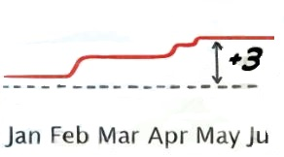
Soft Cap Examples (Adjustment indicator “s”)
Player submits a new score
Soft Cap: Based on formula below, Difference between New calculated HI and LowHI > 3.0 but not >7.0
New calculated HI (8 / 20) | Low HI (L.HI) | New HI – L.HI | 3.0 | > 3.0 | 50% of value > 3.0 (Suppression) | 3 + Suppression | Movement compared to L.HI | New HI
16.0 | 12.0 | 4.0 | 3.0 | 1.0 | 0.5 | 3.0 + 0.5 | 3.5 | 15.5
18.0 | 12.0 | 6.0 | 3.0 | 3.0 | 1.5 | 3.0 + 1.5 | 4.5 | 16.5
19.0 | 12.0 | 7.0 | 3.0 | 4.0 | 2.0 | 3.0 + 2.0 | 5.0 | 17.0

Slide 29
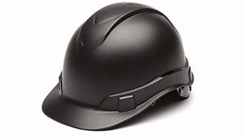
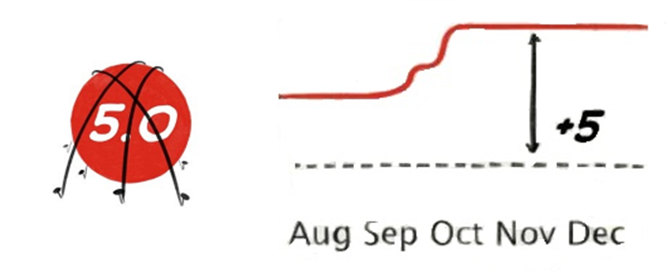
Hard Cap: HI increase capped at 5.0 (Adjustment indicator “h”)
Player submits a new score:
Hard Cap kicks in if new HI is >7 than LowHI
Relevant Numbers |  | Soft Cap |  |  |  |  | Hard Cap
New calculated HI (8 / 20) | Low HI (L.HI) | New HI – L.HI | 3.0 | >3.0 | 50% of value > 3.0 (Suppression) | 3 + Suppression | Movement compared to L.HI | > 5 | New HI
20.0 | 12.0 | 8.0 | 3.0 | 5.0 | 2.5 | 3.0 + 2.5 | 5.5 | 0.5 | 17.0
22.0 | 12.0 | 10.0 | 3.0 | 7.0 | 3.5 | 3.0 + 3.5 | 6.5 | 1.5 | 17.0
23.0 | 12.0 | 11.0 | 3.0 | 8.0 | 4.0 | 3.0 + 4.0 | 7.0 | 2.0 | 17.0

Slide 30
Exceptional Scores (Adjustment indicator “e”)
Score Differential ≥ 7.0 than current HI the Exceptional score adjustment is triggered
If ≥ 7.0 to 9.9 score differential of entered round and score differentials of previous 19 rounds entered are reduced by 1.0 and calculated HI is reduced by 1.0
If score differential is ≥10.0 Score Differential of entered score and score differentials of previous 19 rounds entered are reduced by 2.0 and calculated HI is reduced by 2.0
Another exceptional round will trigger same adjustments. Thus cumulative.
Notes:
The slide is self explanatory.

Slide 31
Playing Conditions Calculation (PCC) ( Adjustment indicator “a”)
Abnormal Playing Conditions = Variance to “Normal conditions” when course was rated.
Possible factors: Rain, Wind, Dry Conditions and Course set up i.e. for Championship events with narrower fairways, longer rough and faster greens.
Calculated using WHS specifications assessing whether playing conditions on the day (AM /PM) makes course significantly harder/easier than when it was rated.
At least 8 scores to be submitted of players with HI ≤ 36.0 for calculation to be triggered
All scores submitted before midnight will be taken into account for PCC calculation, but adjustment is applied to ALL Score Differentials for the day
Score differentials are adjusted either up or down to ensure player’s HI is not impacted by Abnormal Playing Conditions
Is designed to be simple and conservative in nature, adjusting Score Differentials in integer values ranging from -1 (TBC) to +3
PCC adjustments will be posted on HNA website for use by foreign nationals .

Slide 32
Handicap Allowance(HA) and Playing Handicap (PH)

Slide 33
Handicap Allowance (HA)
HA is the percentage by which a golfer’s CH will be reduced based on certain formats of play.
It is stipulated in the Terms of Competition and NOT mandatory
WHS committee did extensive research to determine the percentages which will ensure equity and give all participants an equal opportunity to win a competition for all formats of play whether Authorised or not.
It is separate from the WHS requirements and all scores entered for handicapping purposes must meet the WHS Acceptable Score criteria.
ZGA will publish the WHS HA tables and should HA be applied as a Terms of Competition the HA % for the format of play as published to be used
The recommended Handicap Allowance for Individual. stroke/stableford/par/bogey formats of play is for a medium-size field events (at least 30 players or more). For small-size field events, use 100%.

Slide 34
Playing Handicap (PH)
PH is a handicap used for competition purposes only and is NOT used to determine the Adjusted Gross Score to be submitted for Handicapping purposes.
PH can be
Calculated: using the CH of the player multiplied by the HA and rounded. ≥ 0.5 rounded up and < 0.5 rounded down and is applied for ALL players .
(HNA app enables golfer to determine PH by selecting % and Competition organiser can have conversion table available)
A number stipulated by the Competition organiser as the maximum allowable PH in a certain competition. This will then only affect only those golfers with CH higher than the stipulated maximum PH.
Example: Max PH allowed is 36. All golfers with CH of >36 will use the PH of 36 for the competition. All golfers with CH ≤ 36 will play off their CH
For a specific golfer if Committee decides that HI of player is not correct
These options have different objectives:
The use of HA to determine a PH is for equity to ensure players have an equal chance to win in a certain format of play competition
Stipulation of a maximum PH would be used to speed up play in a busy field or for a specific golfer to ensure fairness if it is considered that HI of player is not reflecting his/her demonstrated ability.

Slide 35
Responsibilities to ensure WHS compliant and fully transportable HI for all ZGA golfers

Slide 36
ZGA Responsibilities
Establish Handicap and Course Rating Committee (H&CRC)
Rights and Responsibilities of ZGA H&CRC
Monitor Club’s compliance with Rules of Handicapping
Ensure compliance with WHS Board agreement
“An authorized National Association has the exclusive rights to implement and administer the World Handicap System within its jurisdiction, including the issuance of a Handicap Index. An authorized National Association may delegate some of its responsibilities to a Regional Golf Association or a golf club.” (Rules of Handicapping)

Slide 37
Provincial Union Responsibilities
Monitor Club compliance to Rules of Handicapping
Act as first level of Appeal for golfers not satisfied with Club Handicap Committee rulings in terms of ZGA Handicap appeal procedure
Annual compliance audit report to ZGA

Slide 38
Club Responsibilities
Establish Handicap Committee.
Ensure Courses are set up as rated. Play to APL.
Notify ZGA promptly of any changes to courses that would invalidate current CR/SR.
Local Rules must be compliant to Model Local Rules as prescribed by 2019 Rules of Golf.
Demarcate course enabling Acceptable Scores for general/recreational play.
Stroke Index allocation in accordance with guidelines.
Assist maintaining data base for unregistered golfers.

Slide 39
Stroke Index (SI) Allocation
The overarching philosophy for SI allocation is to ensure equity
Apply over 18 holes split into 6 triads, evenly matched
Each of three holes in triad ranked on its difficulty relative to par
Difficulty of hole is determined objectively using hole by hole data gathered during Course Rating procedure
Launched on CR App: Mid November 2019

Slide 40
Stroke Index (SI) Allocation (ctn’d)
Formula used:
Scratch value + Bogey value – (2x par)
Example Par 4: Rated Scratch Value is 4.2 and Rated Bogey Value is 5.3
Calculation: (4.2 + 5.3) – (2x4) = 9.6 – 8 = 1.5 over par
Allocation:
Odd SI over front 9 and even SI over Back 9
Spread SI evenly over 18 holes
Apply lowest SI on each nine in the middle triad.
If no hole in middle triad is ranked within the lowest 6 holes relevant to par can move to the end of first triad or beginning of 3rd triad on each nine
If possible avoid consecutive low SI (6 or less) on consecutive holes
Avoid low SI over first three and last three holes

Slide 41
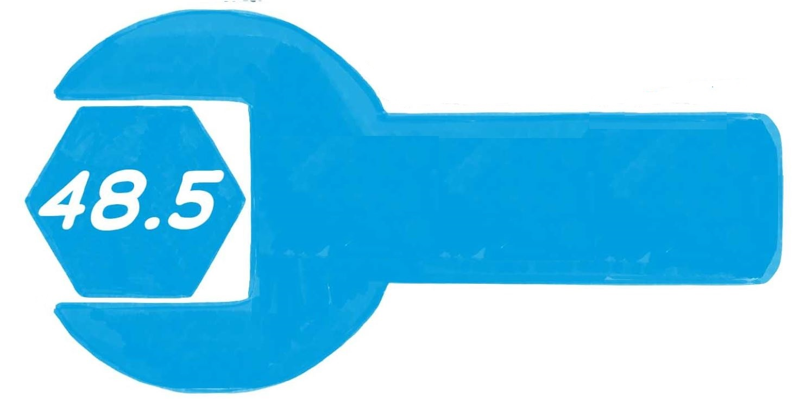
Handicap Committee Actions (Rule 7)
Principle of the Rule:
The Handicap Committee plays a vital role in the successful administration of a player’s Handicap Index and is equipped with tools to intervene when the calculated Handicap Index is no longer reflective of the player’s golfing ability.
Used appropriately, these tools are designed to ensure that players are treated fairly and consistently from golf club to golf club.
The Committee in charge of the competition also plays an important role in setting appropriate Terms of the Competition for all participating players.
7.0

Slide 42
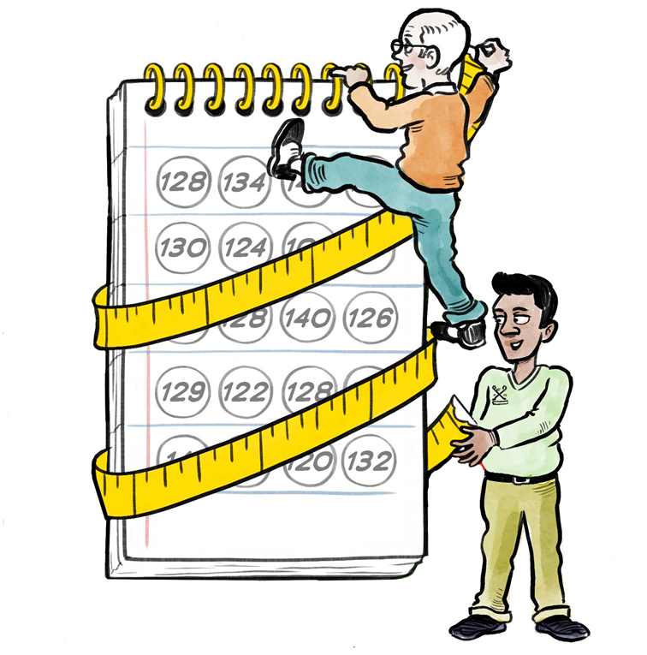
Calculating a Handicap Index
Key Terminology
Handicap Committee | The entity established by a golf club which is responsible for ensuring compliance with the obligations of the golf club under the Rules of Handicapping
Handicap Review | A procedure carried out by the Handicap Committee to determine whether a player’s Handicap Index needs to be adjusted.
Home Club | A player’s primary golf club designated by the player to ensure their Handicap Index is managed in accordance with the Rules of Handicapping.

Slide 43
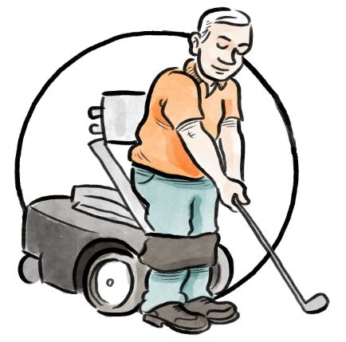
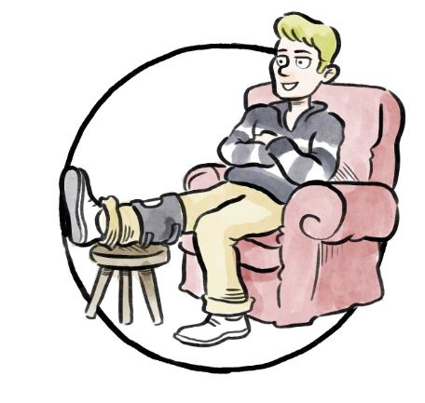
Conducting a Handicap Review
Handicap Committee to conduct a handicap review at least once a year, for all players for which it is responsible
WHS compliant software (HNA) generates reports and give notifications to assist Handicap Committees identify those players requiring a handicap review
A player can request a handicap review, if they believe their Handicap Index no longer reflects their demonstrated ability.
A player must be made aware of, and be involved in, the handicap review process and be able to appeal a decision

Slide 44
Handicap Review
The trend of the player’s Handicap Index - differences in player’s Handicap Index over last 12months/24 months.
Deviations from the expected scoring performance for the player.
Frequency of score submissions in last 12 months v previous 12-month cycles.
Comparison of average score differentials between competitive and casual rounds.
% of acceptable scores from 9-hole rounds.
Comparison of average score differentials in match play v stroke play formats of play.
Any scores from, or performances known, in non-authorized formats of play.
% of acceptable scores submitted at a player’s home club.
The player’s scoring record history.
A review should involve the analysis of any or all of the following information:

Slide 45
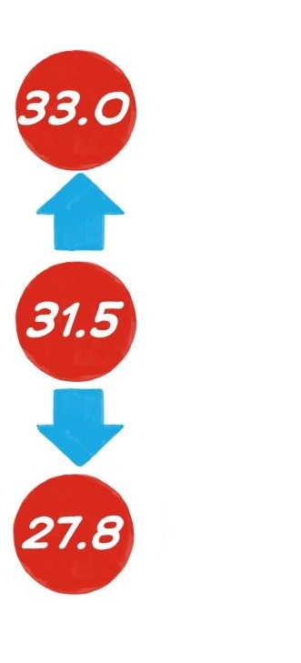
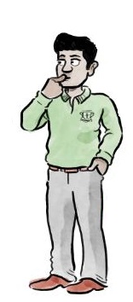
Adjusting a Player’s Handicap Index
When a handicap review has been completed, the Handicap Committee can adjust a player’s Handicap Index to better reflect their demonstrated ability, based on the results of the analysis reports.
The adjustment must satisfy the following criteria:
Be a minimum of 1 full stroke; and
Except in exceptional circumstance, only increase a player’s Handicap Index by up to 5.0 strokes above their Low Handicap Index
There is no limit as to how far downwards a Handicap Index can be adjusted

Slide 46
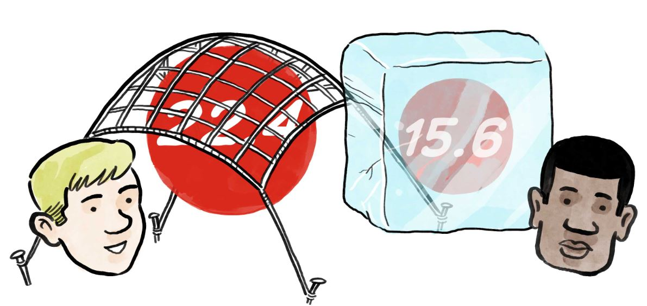
Adjusting a Player’s Handicap Index
Adjustments can be made by:
Resetting the Handicap Index by applying an adjustment to each of the most recent 20 score differentials in the scoring record, to achieve the chosen Handicap Index,
OR
Resetting and/or freezing a Handicap Index for a defined period of time.
If required, the Handicap Committee should consult with the ZGA H &CR Committee before adjusting a player’s Handicap Index

Slide 47
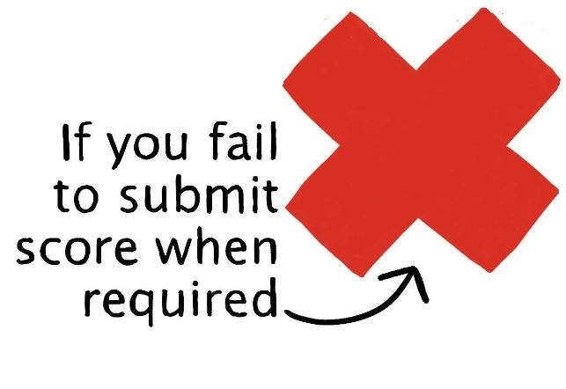
Applying a Penalty Score
If a player fails to submit a score from an authorized format of play, the Handicap Committee should investigate and take appropriate action.
If the reason was valid and an acceptable score is still discoverable, that score will be posted.
If there was no valid reason and an acceptable score is discoverable, that score will be posted. If it was after 24 hours of play a penalty score will be automatically applied.
If the score is not discoverable, a penalty score may be posted.
In the most serious cases, such as repeated failure to submit acceptable scores, the Committee has discretion to apply additional penalty scores, reset the player’s Handicap Index or consider other disciplinary procedures.
PENALTY
SCORE

Slide 48
Withdrawing a Handicap Index
A player’s Handicap Index should be withdrawn if they deliberately or repeatedly fail to comply with their responsibilities under the Rules of Handicapping
A player must be notified of the period of Handicap Index withdrawal and any additional conditions
The withdrawal of a player’s Handicap Index should be applied only after the player has been informed and has had an opportunity to respond
This process will be handled by the Club’s Handicap Committee.

Slide 49
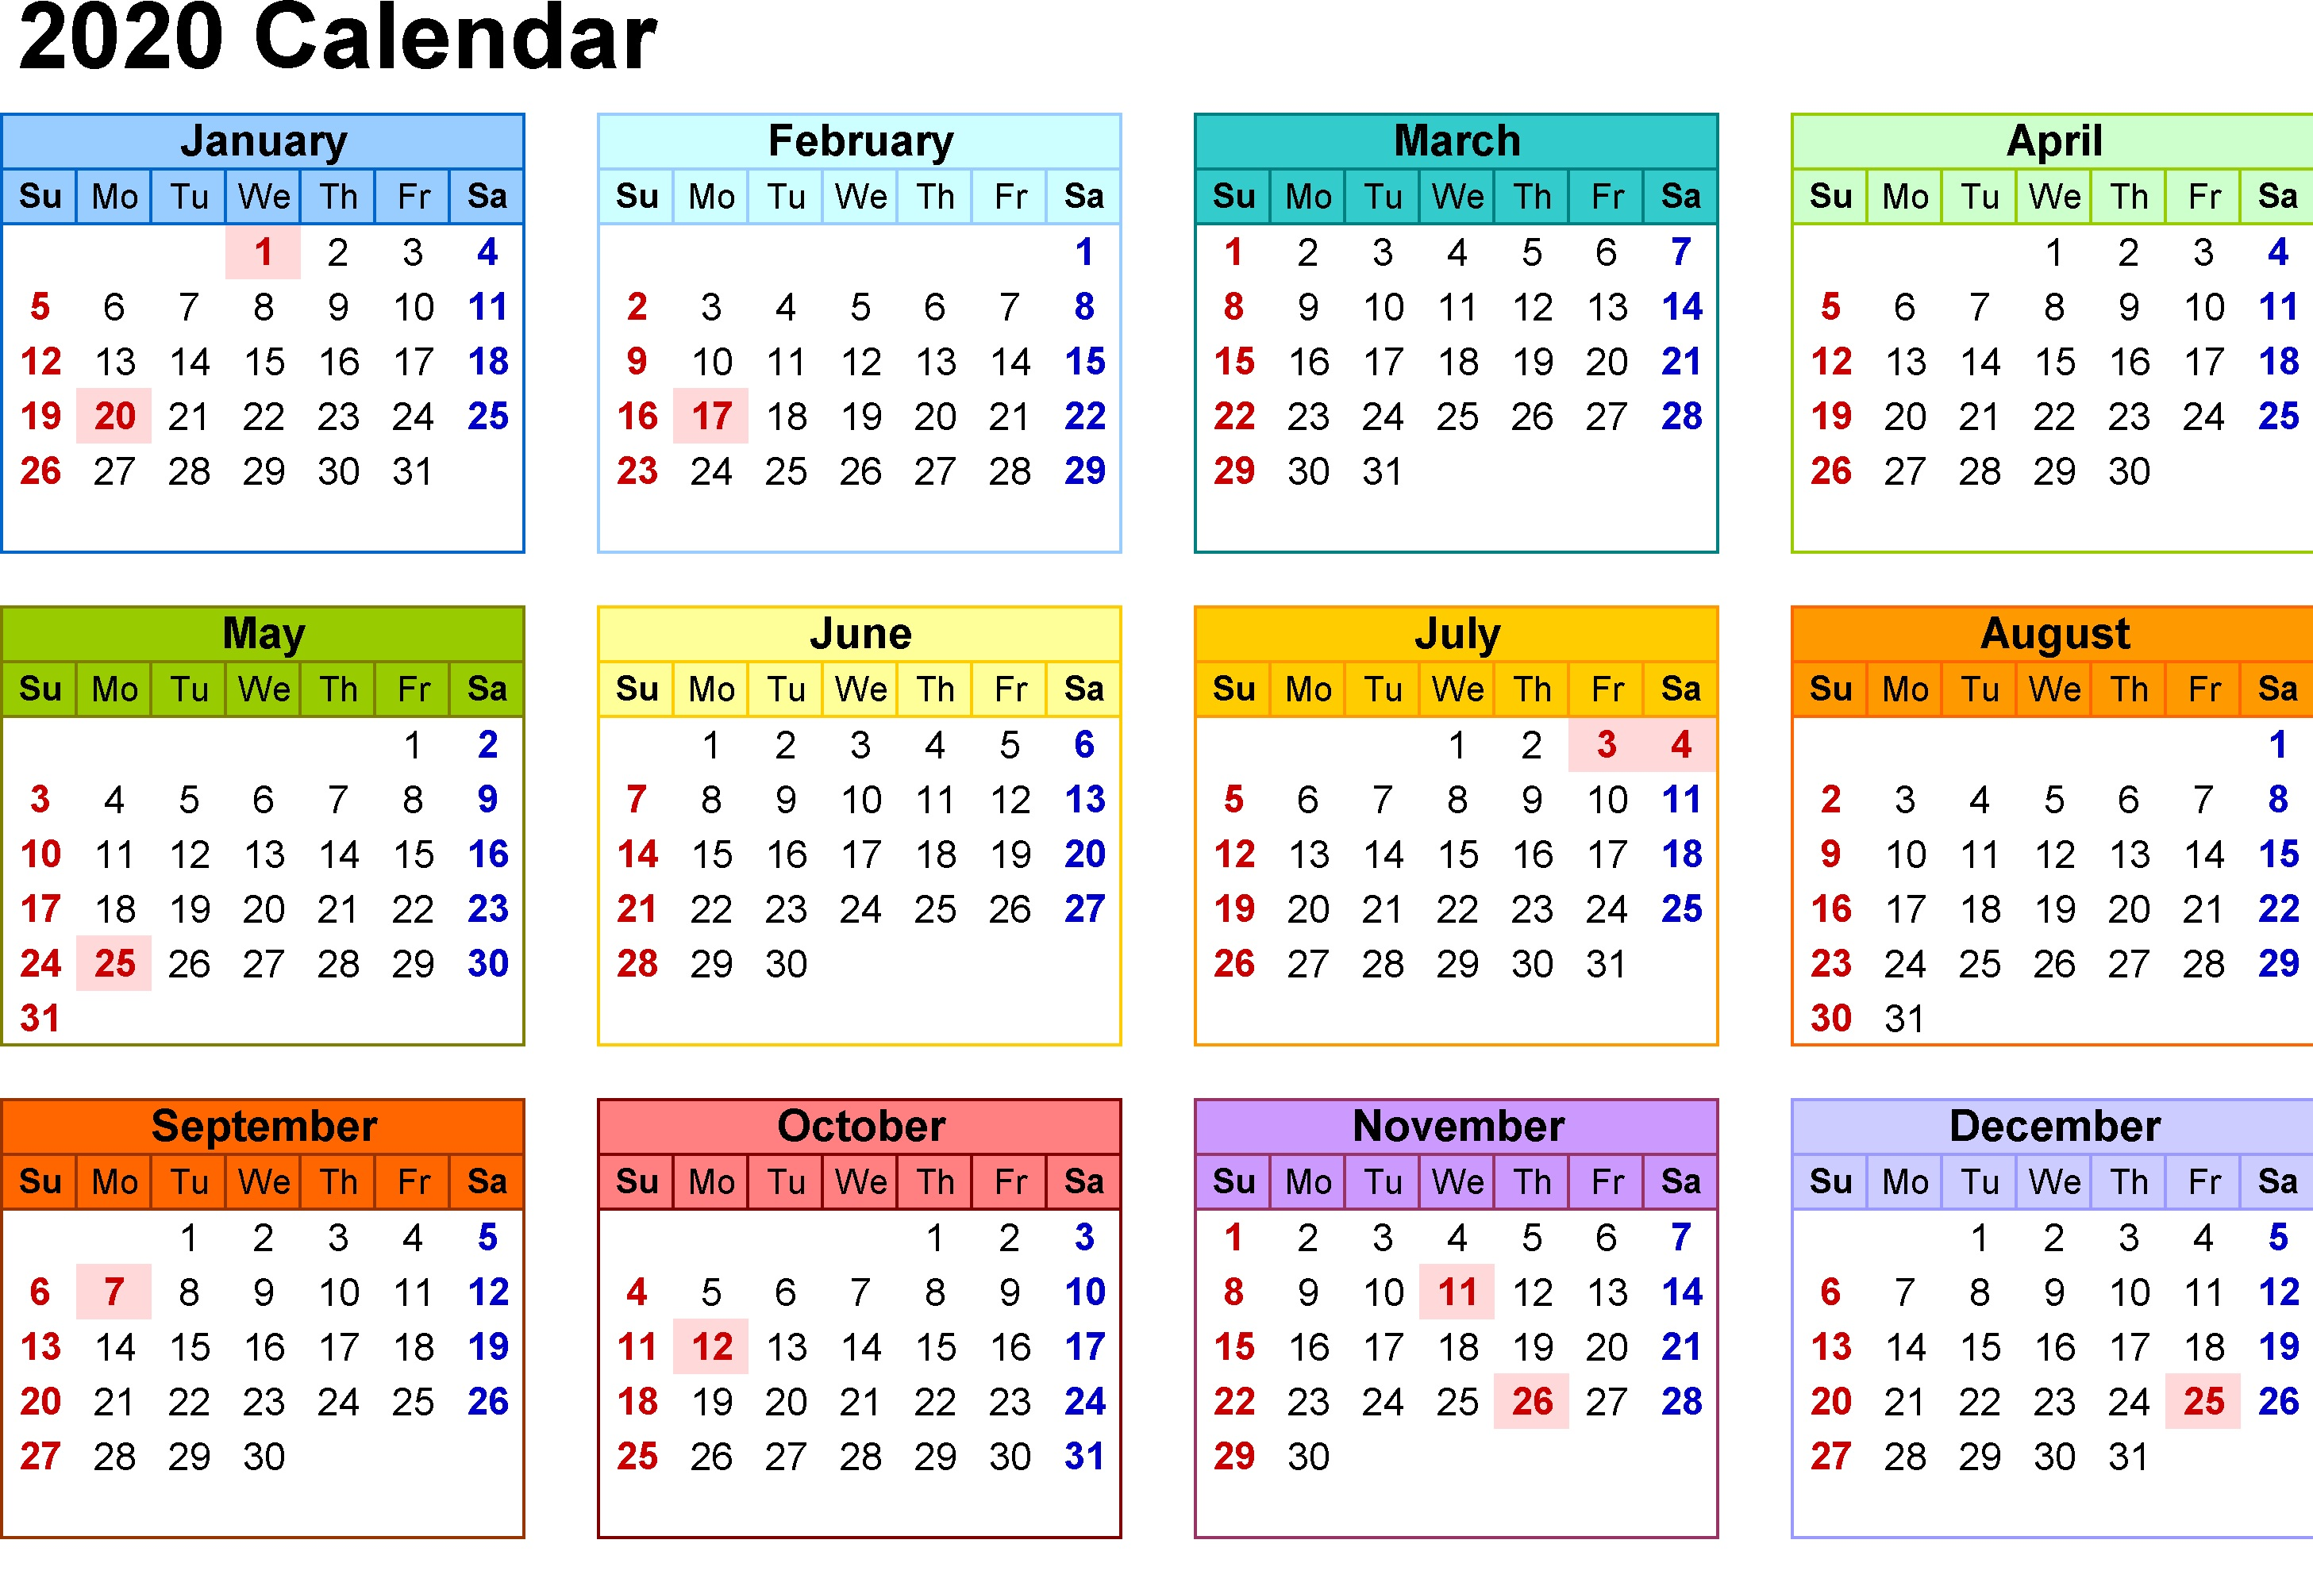
Reinstating a Handicap Index
Reinstatement of a player’s Handicap Index will be required when a player’s Handicap Index has been withdrawn for a period of time, after which it will become eligible to be reinstated.

Slide 50
Considerations When Reinstating a Handicap Index
To determine the level of Handicap Index at which the player is to be reinstated, the Handicap Committee may wish to consider:
Reinstating the Handicap Index at a level that the Handicap Committee feels is currently reflective of the player’s demonstrated ability,
Applying the handicap allocation procedure as if the player were new to the sport, or
Reinstating the last recorded Handicap Index.
The Handicap Committee must monitor the player’s Handicap Index closely over subsequent rounds and, where required, makes appropriate adjustments.

Slide 51
Competition Committee
The Committee in charge of a competition may set eligibility conditions within their Terms of Competition.
For example:
A maximum Handicap Index limit for entry.
A maximum Course Handicap limit for entry
A maximum Playing Handicap.
A Committee may also set the Playing Handicap for a player:
If it has not been updated since the last round was played, or
If there is evidence to suggest that the Handicap Index does not reflect their ability

Slide 52
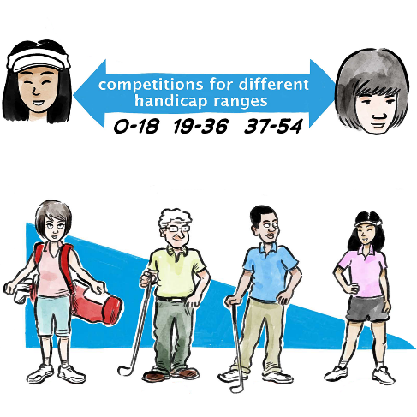
Terms of Competition
Where a player is required to compete with a Playing Handicap not calculated directly from their current Handicap Index – that Playing Handicap is only relevant for competition purposes.
When updating the player’s Handicap Index, the correct Course Handicap should be used to determine the Adjusted Gross Score to be submitted for handicapping purposes.

Slide 53
Multi-round Competitions
For competitions played on the same day or consecutive days, it is strongly recommended that the Handicap Index used at the start of the competition is used for the duration of the event.
This is for ease of competition administration purposes.
This provision should be stated clearly in the Terms of the Competition.
Scores should still be posted by the end of each day.

Slide 54
Responsibility of Committees
Ensuring scores are submitted promptly after round or by end of day
Review and Act on Management reports received from HNA
Conducting Handicap Reviews
Establishing Terms of Competition with information about Handicap Index or Playing Handicap to use
Acting as Home Club or collaborating with a player’s Home Club
Understanding rights and responsibilities as delegated by ZGA

Slide 55
Golfer Responsibilities
Play in accordance with the Rules of Golf
Play in accordance with the Rules of Handicapping to ensure acceptable scores
Enter Adjusted Gross Score as soon as possible but before midnight on day of play
Be responsible for peer review

