Slide 1
2020 WHS Implementation Preparation, Zimbabwe
Prepared by Wimpie J du Plessis
October/November 2019

Slide 2
AGENDA
Introducing Raters : Dave Tiffin and Wimpie du Plessis
Course Rating System explained
Permanent tee markers and measurement of Average Playing Length
Set up of course - Impact of variance – Guidelines for training of ground staff
Scorecard design
Process for golfers to obtain Course Handicap
From now to Implementation Date.
- Dissemination of information to members
- From Current Handicap to Handicap Index
World Handicapping System

Slide 3
Rules of Handicapping

Slide 4
Fully Transportable HI 2020

Slide 5
Definitions and Essential terms used in THE course rating system and Rules of Handicapping

Slide 6
Course Rating System/RoH Terms
Course Rating:
The Course Rating is the evaluation of the playing difficulty of a course for scratch golfers . It is expressed as the number of strokes taken to one decimal place (72.5)
Scratch Golfer:
A scratch golfer is a player with HI of 0.0 and who can play all rated courses to its course rating. A male scratch golfer, can hit tee shots an average of 228 metres and can reach a 430 metre hole in two shots and A female scratch golfer can hit tee shots an average of 192 metres and can reach a 365 metre hole in two shots at courses < 610 m.

Slide 7
Course Rating System/RoH Terms (cont’d)
Bogey Golfer:
A Male bogey golfer is a player who has a Handicap Index of approximately 20.0 . He can hit tee shots an average of 183 metres and can reach a 340 metre hole in two shots at sea level. A Female bogey golfer is a player who has a Handicap Index of approximately 24.0 She can hit tee shots an average of 137 metres and can reach a 256 metre hole in two shots at courses < 610m
Bogey Rating:
A Bogey Rating is the evaluation of the playing difficulty of a course for bogey golfers. It is expressed as the number of strokes taken to one decimal place (92.1)

Slide 8
Course Rating System/RoH Terms (cont’d)
Slope Rating:
Slope Rating indicates the measurement of the relative playing difficulty of a course for players who are not scratch golfers, compared to scratch golfers. It is computed from the difference between the Bogey Rating and the Course Rating times a constant factor (5.381 for men and 4.241 for women) and is expressed as a whole number from 55 to 155.
Standard difficulty of 113:
The slope rating for a course of standard difficulty is 113. This is when there is no difference between how hard the course plays for a scratch player and a golfer with a higher handicap. There would therefore be no slope adjustment to the players handicap index for a course or tee with a 113 slope.

Slide 9
Course Rating System/RoH Terms (cont’d)
Handicap Index (HI)
The Handicap Index is an indication of the demonstrated ability of the golfer and is used in the calculation to determine the handicap the golfer will use on the day i.e. Course Handicap .
HI is expressed to one decimal point. i.e. 7.2
HI is the Average of the Best 8 of last 20 Score Differentials

Slide 10
Course Rating System/RoH Terms (cont’d)
Score Differential
A Score Differential is calculated from the players gross score, adjusted for the maximum allowed on a hole minus the Course Rating and Playing Condition Calculation (PCC) adjustment using the following formula and includes an adjustment of the slope of the tee played
Score Differential = (Adjusted Gross Score – CR – PCC) *113/SR

Slide 11
Determining Adjustable Gross Score: Nett Double Bogey (NDB)
Always calculated using the CH applicable for course played.
Max allowable score per hole and score to be recorded is NDB except for new golfers with no HI and players with HI ≥ 54.0 where max is Par +5
NDB is score = 0 Stableford points or when you “ring out”
Easy to remember : If you do not stroke : Par +2, If you stroke: Par +3 if you double stroke : Par + 4
Example: Player with CH of 18 . On Par 3
Number of shots | Stableford Points
2 | 4
3 | 3
4 | 2
5 | 1
6 | 0
Max and Score to be recorded = 6

Slide 12
Adjustable Gross Score when Hole not completed: Most Likely Score (MLS)
When format of play results in a golfer not completing a hole such as Better Ball, Alliance and Match Play formats the golfer should record the MLS with the Max = NDB

Slide 13
Course Rating System/RoH Terms (cont’d)
Course Handicap:
The Course Handicap is the calculated handicap the golfer will use on the day, based on the Course (tee) they select and includes the adjustment to Par.
The Course Handicap is calculated as follows.
Course Handicap = Handicap Index *Slope /113 +(CR-Par)
(Examples on next slide)
It is a rounded number, where a decimal < 0, 5 will be rounded down, and a decimal ≥ 0,5 will be rounded up. Rounding ONLY after calculation is completed
And, it is the number the golfer will use to record their scores

Slide 14
Course Handicap Calculation Examples Course Handicap (CH) = Handicap Index *Slope /113 +(CR-Par)
Golfer with Handicap Index (HI) of 15.4
Club A: Red Course:
Course Rating (CR) = 68.8 and Slope Rating = 122. Par 72
CH: 15.4*122/113 = 16.6 - 3.2 = 13.4 rounded to 13. CH = 13
Club B: Red Course
Course Rating (CR) = 65.2 and Slope Rating = 118. Par 72
CH: 15.4*118/113= 16.1 – 6.8 = 9.2 rounded to 9. CH = 9
Note : Because adjustment to par is incorporated in CH calculation NO further adjustments are made to the handicap of golfers when playing off different tees.

Slide 15
Examples of Course Handicap at 2 different Clubs
Club A Par 72 course | Men (course/slope) | Women (course/slope) | Course H.cap for 15.4 H.I. Men | Course Handicap for 18.6 H.I. Women
Yellow | 76.8/142 | N/A | 24
White | 74.1/136 | N/A | 21
Blue | 72.0/128 | 78.3/152 | 17 | 31
Red | 68.8/122 | 74.6/143 | 13 | 26
Club B Par 72 course | Men (course/slope) | Women (course/slope) | Course H.cap for 15.4 H.I. Men | Course Handicap for 18.6 H.I. Women
Yellow | 74.8/139 | N/A | 22
White | 72.2/130 | N/A | 18
Blue | 69.1/120 | 73.5/136 | 13 | 24
Red | 65.2/118 | 72.1/130 | 9 | 21

Slide 16
Playing Handicap (PH)
Playing Handicap (PH) is based on the Terms of Competition or Handicap Allowances applicable for certain formats of play
Committee decision: Terms of Competition
PH = CH * Handicap Allowance or
Determined by Terms of Competition
CH remains the number golfers must use to determine their Adjusted Gross Score
PH is only used to determine the results of a competition and is not used for handicapping purposes.

Slide 17
Overview of rating data used to determine THE course and slope ratings

Slide 18
How are the Course Ratings determined
Two key parameters determine Course and Slope Ratings
Effective Playing Length, and
Obstacle Stroke Value
There are standards to define a Scratch and Bogey golfer’s shot length for rating purposes to determine landing zones

Slide 19
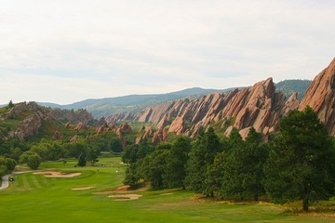
Effective Playing Length (EPL)
Five factors to determine the true playing length of a hole
Roll
Change in Elevation
Doglegs and Lay up
Wind
Altitude

Slide 20
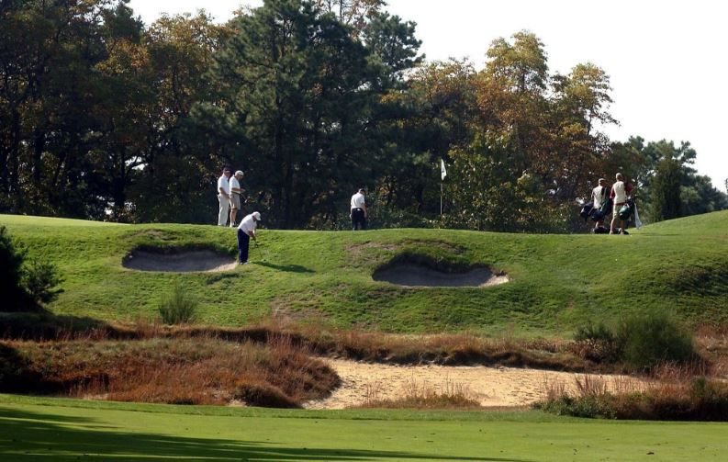
Obstacle Stroke Value Numerical value from 0 -10 (0=non-existent, 10 = extreme)
Each hole is analysed for obstacles affecting playing difficulty and 10 obstacles are noted.
Topography
Fairway Width at landing zones
Green Target
Recoverability and Rough
Bunkers
Penalty Area Lateral
Penalty Area Crossing
Trees
Green surface
Psychological

Slide 21
Slope indicates the mathematical slope of a line when plotting scores on a graph against a Handicap Index.

Slide 22
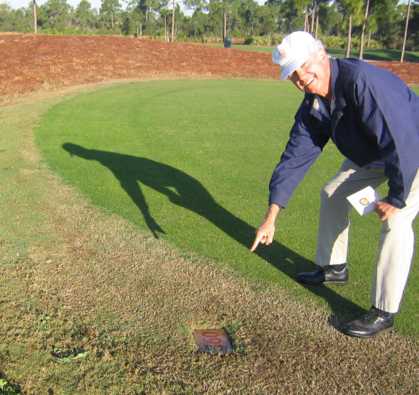
Permanent Tee markers and measurement of holes

Slide 23
Permanent Tee Markers (PTM)
Course Rating Guidelines:
Permanent Tee Markers positioning
(Guidelines on next slides 3 slides)
It is a permanent fixture and colour coded to reflect the colour of the course (tee) as per the scorecard AND as listed on the HNA/Handicapping system
They may not be closer than 2 metres from front and
4 metres from back of tee box (except when more than one tee box is consistently used)
The length of the hole is measured from this PTM to the middle of the green (horizontally/air line)
PTM are one of the most important compliance factors to ensure courses are set up consistently on a daily basis.

Slide 24
Positioning of Permanent Tee Markers
where a single teeing area is used per set of tees:
When a single tee box is designated for one set of tees, placement of the PTM is at a point opposite the middle of the teeing area.
This maximises the ability of the club to use the entire teeing area and gives the best chance of consistently setting up the course to the Average Playing Length (APL)

Slide 25
Positioning of Permanent Tee Markers
where more than one teeing area is consistently used:
Where movable tee markers may alternate from day-to-day between two or more tee boxes, it is permissible for the PTM to be positioned on the edge of the one tee box or in the rough between these tee boxes
The starting point for measuring of the hole is the exact position of the PTM to middle green

Slide 26
Positioning of Permanent Tee Markers
where one teeing area is used for multiple tees
When more than one set of tee markers uses a single tee box, consider the percentage of a course's existing or anticipated play from each set of tees when determining Permanent tee marker placement.
Allocate the percentage of play for each tee and place each PTM at the mid-point of each of the allocated areas.
Example where a teeing area is shared by three sets of tees.
The club determines that 25 percent of play will be from the forward tees, 50 percent from the middle tees, and 25 percent from the back tees.
The Permanent marker should be at the mid-point of each of these three areas.

Slide 27
Measurements of Holes

Slide 28
Measurement of courses (tee) to determine Average Playing Length (APL) of each course (tee)
The measurement of each hole is from PTM to middle green. (Horizontally /air line)
The measurement should take cognisance of pivot points should the hole not be straight .
(See next slide for measuring techniques)
Each hole is measured using this method and the sum of the 9 or 18 holes so measured, is the Average Playing Length (APL) or distance to be recorded on the scorecard for each of the different colour courses (set of tees).
To ensure players play distinct courses, the APL between the different colour courses (sets of tees) should be > 300 m preferably 450 m at sea level (<610 m)

Slide 30
Set up of a Course

Slide 31
Set up of course
Courses (set of tees) must be set up every time in such a manner to ensure the length of the course measures to the APL as per the scorecard
The set up of each hole should be within 20 m of the measured length of the hole
Every 20 metre difference to APL on the scorecard equates to 0.1 difference on the Handicap Index
Should a course be set up much longer or shorter than the APL, for handicap purposes, golfers may not enter the score achieved on that day since they did not play a rated course.
It is recommended that templates (see next slide) be drawn up to ensure that Ground Staff set up the courses to the APL as per the scorecard

Slide 32
Course Set up Template Example
Template 1 : YELLOW COURSE
HOLE | TEE | GREEN | VARIANCE
1 | 5 | -2 | 3
2 | -3 | -5 | -8
3 | 4 | -3 | 1
4 | 15 | 5 | 20
5 | -18 | 9 | -9
6 | 10 | 4 | 14
7 | 15 | 5 | 20
8 | -12 | -5 | -17
9 | -11 | -3 | -14
10 | 5 | -2 | 3
11 | 3 | -1 | 2
12 | 0 | 0 | 0
13 | 5 | 0 | 5
14 | -9 | 11 | 2
15 | -2 | -5 | -7
16 | -4 | -3 | -7
17 | 2 | -2 | 0
18 | 5 | -5 | 0
NET | 10 | -2 | 8
Average Playing Length (scorecard) | 6000
Template 1 Playing Length | 6008

Slide 33
Other course set up considerations
Courses should not be set up shorter for special days, e.g. corporate days. It would be better to select the appropriate course the corporate day participants should play, e.g. the Blue Course which is shorter than the White Course.
Course Maintenance (temporary greens)
Handicapped competitions such as Pro-Am events where set-up of courses differ from the rated APL, applications should be made to the responsible person at the Handicap management entity to determine the appropriate Course and Slope Ratings for this specific set up.

Slide 34
Score cards

Slide 35
No longer Gender or Age based tees Scorecard design to reflect this change
All colour courses (tees) i.e. Yellow, White, Blue and Red, should be shown together. Shortest course, i.e. red at most clubs, should not be separated out
Recommended colour courses are : Yellow for longest course, then White, then Blue and Red for the shortest course.
Should the club have more than 4 sets of tees it is recommended that Black be added as the longest course or Green as the shortest course.
9 hole courses with only two tees should use White (longest) and Red (shortest)
The same colours to be used for both 9’s and clearly mark the hole number, e.g. White 1 , White 10, Red 2 , Red 11,etc
Colours of courses should be reflected on the scorecard and the HNA/Handicapping system

Slide 36
No longer Gender or Age based tees Scorecard design to reflect this change
The Par of each hole for men and women, should be the same
Should this not be possible, the Par for men and women must be shown below each other, on distinct separate line, similar to the Stroke Index example referred to below. Par is not linked to any colour course (set of tees) but gender based.
It is preferable to have the same Stroke Index for men and women. Should this not be the case, it should be shown on a distinct separate line as per the scorecard example of the Fazio Pronghorn course.

Slide 37
 |  | PLAYER |  |  |  |  | MEMBER NR. |  | TEE COLOUR |  |  | HI |  | CH |  | PH |  | COMPETITION: |  |  |  |  |  |  |  |  |  | RESULT
 | A
 | B
 |  | MARKER
 | C |  |  |  |  |  |  |  |  |  |  |  |  |  |  |  |  | DATE: |  |  |  |  | TIME:
 | D
 |  | HOLE |  | 1 | 2 | 3 | 4 | 5 | 6 | 7 | 8 | 9 | OUT |  |  |  |  | 10 | 11 | 12 | 13 | 14 | 15 | 16 | 17 | 18 | IN | TOTAL
 | DISTANCE | WHITE |  |  |  |  |  |  |  |  |  |  |  |  |  |  |  |  |  |  |  |  |  |  |  |  |  | 0
 |  | BLUE |  |  |  |  |  |  |  |  |  |  |  |  |  |  |  |  |  |  |  |  |  |  |  |  |  | 0
 |  | RED |  |  |  |  |  |  |  |  |  |  |  |  |  |  |  |  |  |  |  |  |  |  |  |  |  | 0
 |  | PAR |  |  |  |  |  |  |  |  |  |  |  |  |  |  |  |  |  |  |  |  |  |  |  |  |  | 0
 |  | STROKE |  |  |  |  |  |  |  |  |  |  |  |  |  |  |  |  |  |  |  |  |  |  |  |  |  | GROSS | NETT
 | PLAYER | A | SCORE
 |  |  | RESULT
 |  | B | SCORE
 |  |  | RESULT
 |  | B/B SCORE
 |  | ALLIANCE
 |  | B/B SCORE
 | MARKER | C | SCORE
 |  |  | RESULT
 |  | D | SCORE
 |  |  | RESULT
 | PLAY THE COURSE TO SUIT YOUR GAME |  |  | WOMEN |  |  |  | MEN
 |  |  |  | BLUE |  | RED |  | WHITE |  | BLUE |  | RED
 | SLOPE Rating
 | COURSE Rating |  |  |  |  |  |  |  |  |  |  |  |  |  |  |  |  | PLAYER: |  |  |  |  |  |  | MARKER

Slide 38
Information required on scorecards
Name of Player
Colour Course (tees) the player elected to play. By a cross or writing Y/W/B/R if tee colour boxes are not on the scorecard
Handicap Index (HI)
Course Handicap : (CH)
Playing Handicap: (PH)
 | PLAYER |  |  |  |  | TEE COLOUR |  |  |  |  |  | H/CAP INDEX |  | COURSE H/CAP |  | PH
A
B
 | MARKER
C
D

Slide 39
Holes with different stroke index (HDCP)/Par for Men and Women : Design layout

Slide 40
Course Handicap
Process to obtain Course Handicap

Slide 41
Biggest change for the Golfers: Course Handicap
The handicap to be used on the day will depend on the course (tee) the golfer plays
The golfer(s) decides which course is to be played on the day, e.g. white, blue or red
He/she then obtains his/her “Course Handicap” before tee off
The Course Handicap is used for completing the scorecard
Handicap Index and colour course to be noted next to Course Handicap if space is not provided on the scorecard
The golfer’s Adjusted Gross score for the round will be entered on the Handicap System and the system will re-calculate the Handicap Index on the HNA/Handicap system daily after midnight.

Slide 42
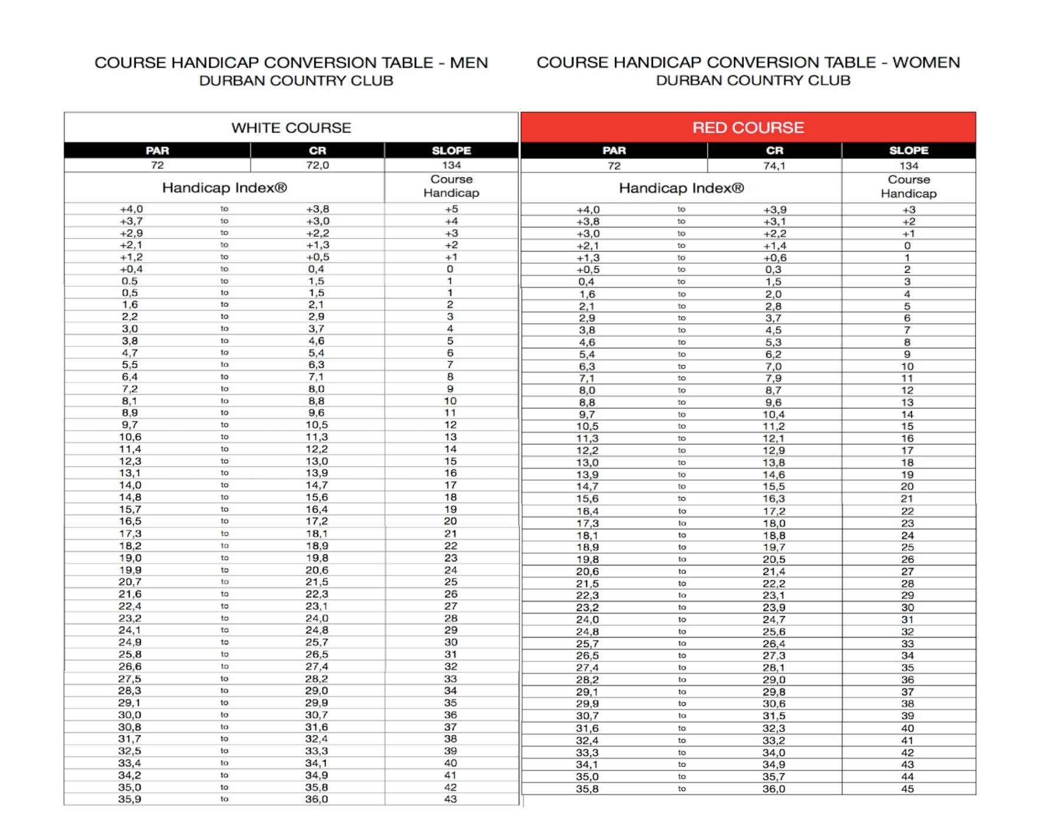
Example of CHCT displayed at clubs

Slide 43
Look up CH on Course Handicap Conversion Tables (CHCT)
Sun City Black Course Men | Champagne Sports Resort White C. Men
Par 72 CR 78.2 SR 155 | Par 72 CR 72.3 SR 141
Handicap Index® | Course Handicap
+5.0 to + 4.9 | +1
+4.8 to +4.2 | 0
+4.1 to +3.5 | 1
+3.4 to +2.7 | 2
+2.6 to +2.0 | 3
+1.9 to +1.3 | 4
+1.2 to +0.6 | 5
+0.5 to 0.2 | 6
0.3 to 0.9 | 7
1.0 to 1.6 | 8
Handicap Index® | Course Handicap
+3.0 to +2.3 | +3
+2.1 to +1.5 | +2
+1.4 to +0.7 | +1
+0.6 to 0.1 | 0
0.2 to 0.9 | 1
1.0 to 1.7 | 2
1.8 to 2.5 | 3
2.6 to 3.3 | 4
3.4 to 4.1 | 5
4.2 to 4.9 | 6

Slide 44
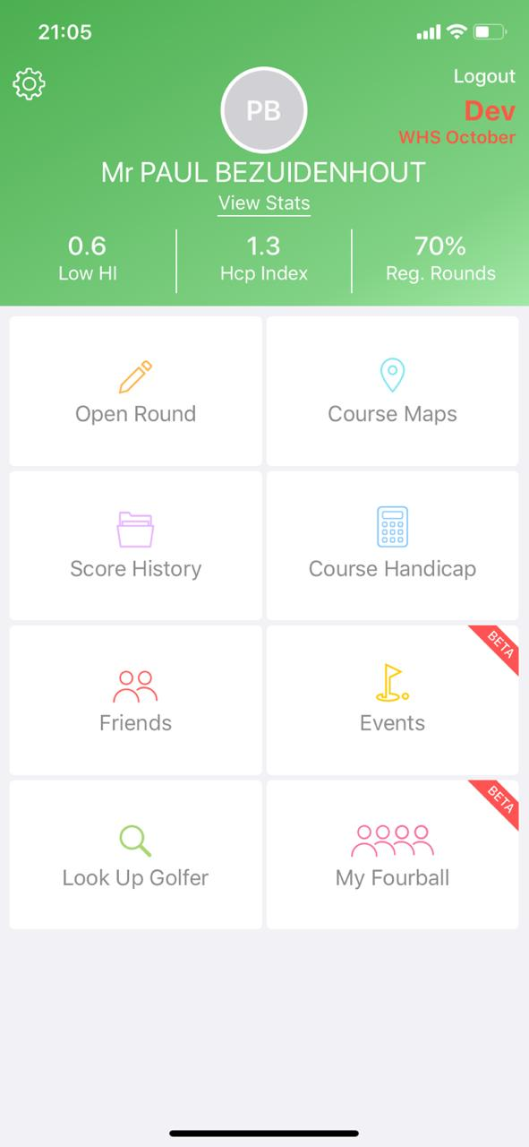
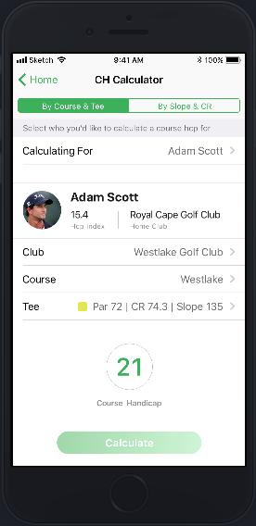
Make it easy for golfers to obtain CH : Example: HNA Phone App. Used in SADC countries

Slide 45
HNA Terminals : Swipe your card

Slide 46
Select your tee

Slide 47
Course Handicap Displayed

Slide 48
Plus hole allocation
+ 6 HI can result in a CH up to +11 in certain instances.
Clubs to do the calculation based on CR/SR of their colour courses and show information on scorecard

Slide 49
Recommended Plus hole allocation
When deciding on plus strokes, it is important to consider that the allocation does not necessarily correlates to the stroking. The main consideration is where a plus golfer would have the highest chance of playing the hole under par
The proposed sequence of allocation is as follows:
+1 is easiest par 5 on the even stroked nine
+2 is the easiest par 5 on the odd stroked nine
+3 is the other par 5 on the even stroked nine
+4 is the other par 5 on the odd stroked nine
+5 is the easiest par 4 on the even stroked nine
+6 is the easiest par 4 on the odd stroked nine
+7 is the second easiest par 4 on the even stroked nine
+8 is the second easiest par 4 on the odd stroked nine
Etc.

